Slide 1


Decentralized financial ecosystem based on BitShares 2.0 (Graphene)
www.deex.exchange

Slide 2

About DEEX
A currency exchange with an unprecedented level of data protection providing access to trading both for market professionals and ordinary users;
Platform for safe ICO based on a decentralized escrow provided by DESCROW.ORG;
Decentralized blockchain crypto-fund with the ability to issue tokens and its automatically placement on stock exchanges;
Cryptocurrency debet cards;
Own agency network of ATMs for the purchase and sale of cryptocurrency for fiat money with the ability to work with bank cards.

Slide 3
DEEX tokens
DEEX.CORE is the basic token which gives the right to receive a certain share of profit from the activities of the exchange. This is a mutually beneficial and low-risk investment, the profitability of which will grow as the profitability of the project increases. The owners of the token will be entitled to a proportional share of the profit on the exchange site and from all projects that will be added in the future.
DEEX.ICO is an ICO token which allows to receive profit from the ICO without having to study the details of each individual innovation project. By purchasing a token you can earn revenue from all conducted ICOs.

Slide 4
DEEX main advantages
A convenient GUI, compatible with the most modern browsers;
Desktop application for trading;
Mobile app for Android and IOs;
24/7 technical support;
A large number of trading pairs;
The possibility of recovering lost passwords;
Two-factor authentification;
Wide range of trading indicators;
High liquidity;
Own hardware crypto-wallet for cold storage of cryptocurrencies and tokens.

Slide 5
DEEX and BITSHARES
DEEX operates on the BitShares 2.0 platform - a high-tech, decentralized blockchain platform that allows you to create highly efficient financial smart contracts for all areas of economic activity that are used on the Internet.
The BitShares 2.0 platform provides many undeniable advantages:
Decentralization;
The performance up to 100 000 transactions per second;
Crypto trading with the stable price (BitAssets/SmartCoin);
The ability to realize periodic and planned payments;
Referral remuneration program.

Slide 6
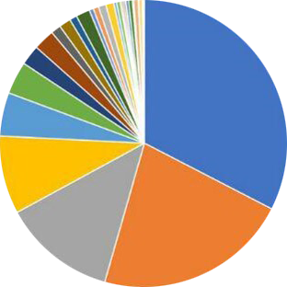
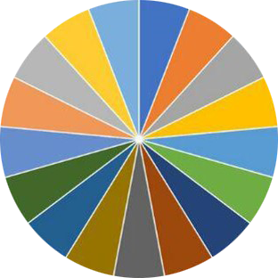
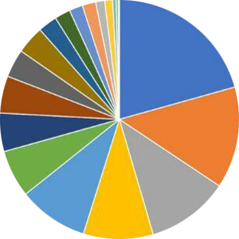
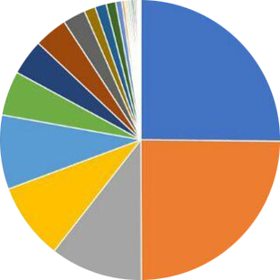
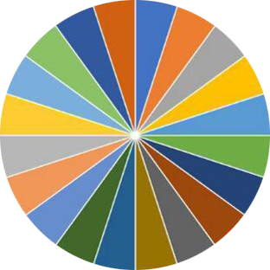
According to the statistics of many observers, Bitshares is the most decentralized system.
WAVES (LPOS)
Active Witnesses (17, 73 Standby) 2017-10-11
BITSHARES (DPOS)
Active Witnesses (17, 73 Standby) 2017-10-11
SO WHICH
VALIDATORS
ARE MORE
DECENTRALIZED
BITCOIN (POW)
Mining Pools 2017-10-11
ETHEREUM (POW)
Mining Pools 2017-10-11
STEEM (DPOS)
Active Witnesses (20, 68 Standby) 2017-10-11

Slide 7
DEEX PRE-ICO and ICO
The planned amount of investment for presale is about $ 3,000 000. The collected funds will be spend to refine the prototype system and MVP launch;
Token’s base price is connected to the USD and set on the level of 0.10$;
Funds will be collected through the ETH smart contracts as well as through the ETC, BitShares, Bitcoin, DASH;
Tokens will be automatically placed on the decentralized exchanges Openledger.io, RuDEX, as well on a partners exchanges in South-East Asia.

Slide 8
DEEX Monetization
The platform will calculate and transfer to the escrow account a floating commission of 0.2% -0.5% from sales of cryptocurrencies, tokens and other digital assets;
The platform will provide an opportunity to buy cryptocurrencies, cryptocurrency pairs and tokens with a shoulder (margin lending). The leverage will be calculated by the algorithm considering on the reputation, account status and customer history and will be executed through the EOS smart contract;
The platform will earn profit by selling the technology of data exchange with other cryptocurrency exchanges through API technology and developer services (SDK) for additional tools which extend the functionality of trading;
Integration of the possibility to carrying out transactional models and obtaining standard deductions from such operations will also bring revenue to the platform that will be credited to the holders’ (investors) tokens.

Slide 9
DEEX development
October 23rd, 2017 - launch of the presale (https://predico.deex.exchange);
November 2017 – MVP launching and testing DEEX on the BitShares-based engine;
February 2018 - customization of the basic engine, the introduction of the possibility of password recovery and two-factor authentication;
December 2017 - launch of the large-scale ICO of the main ecosystem token DEEX.CORE;
January 2018 - launch of the mobile exchange application;
February 2018 - launch of branded ATMs in Spain, Turkey, Germany, Russia, Kazakhstan, Italy, Malta;
December 2018 - transfer the engine of the ecosystem into its own Graphene-based blockchain.

Slide 10
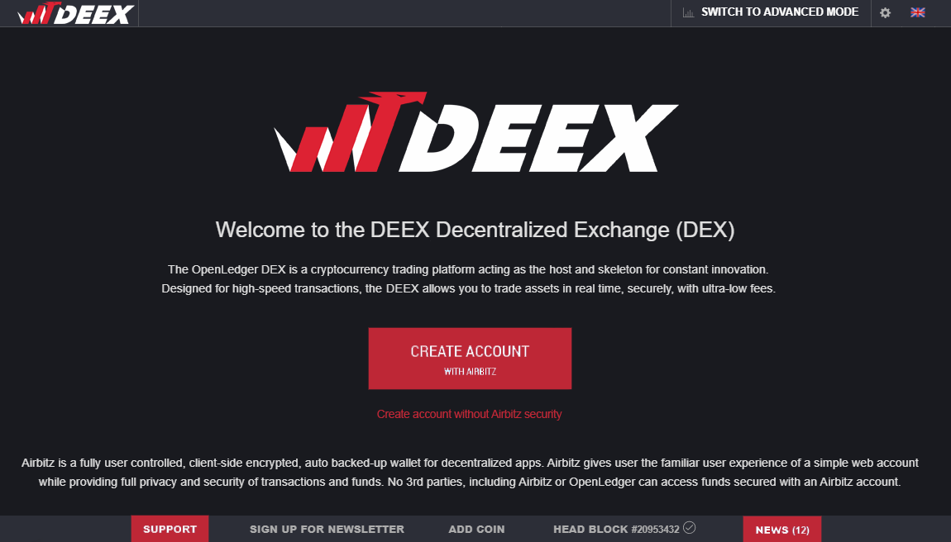

Slide 11
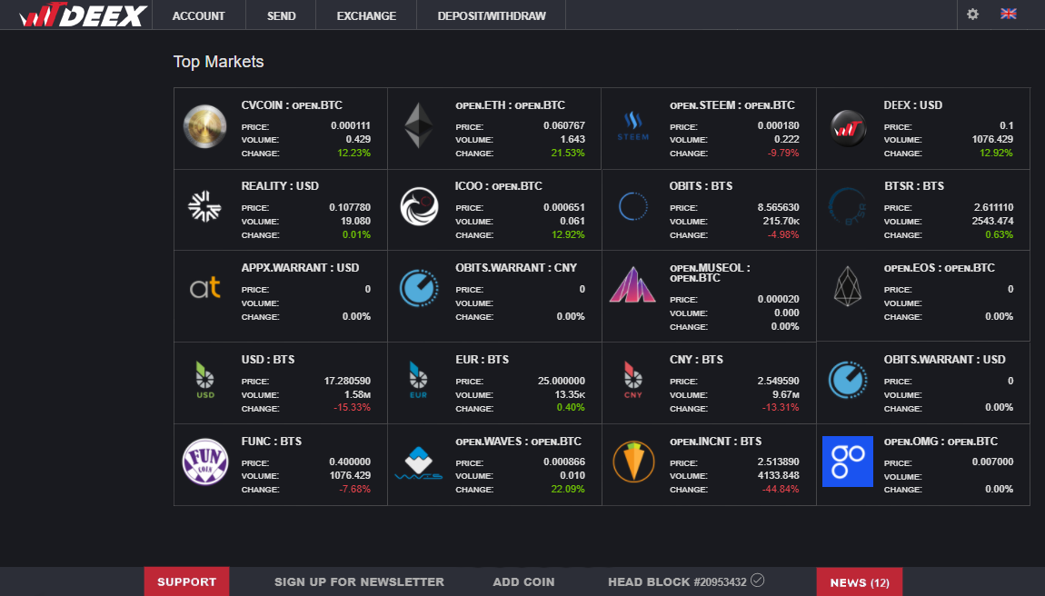

Slide 12
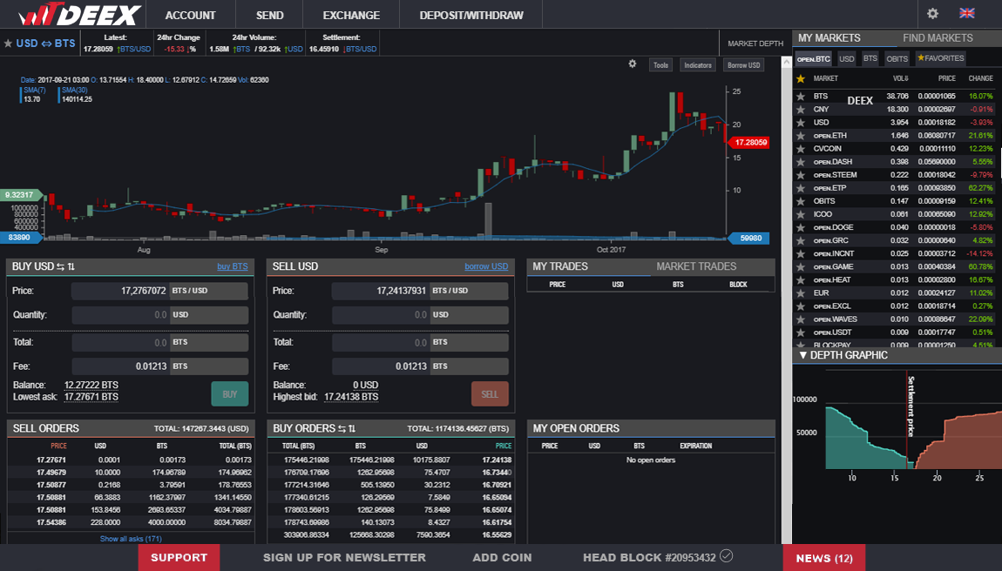

Slide 13
Become the part of a decentralized future with DEEX! Contacts: www.deex.exchange
+7 499 3933319 info@deex.exchange

Slide 14
DEEX ecosystem’s partners projects

Slide 15
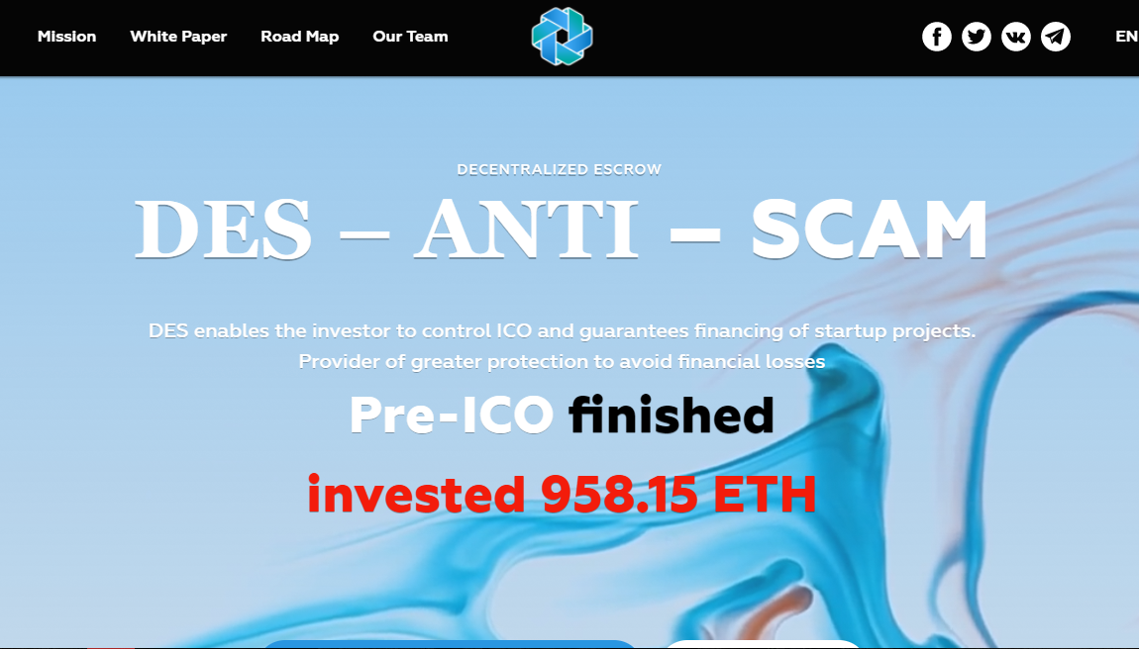

Slide 16
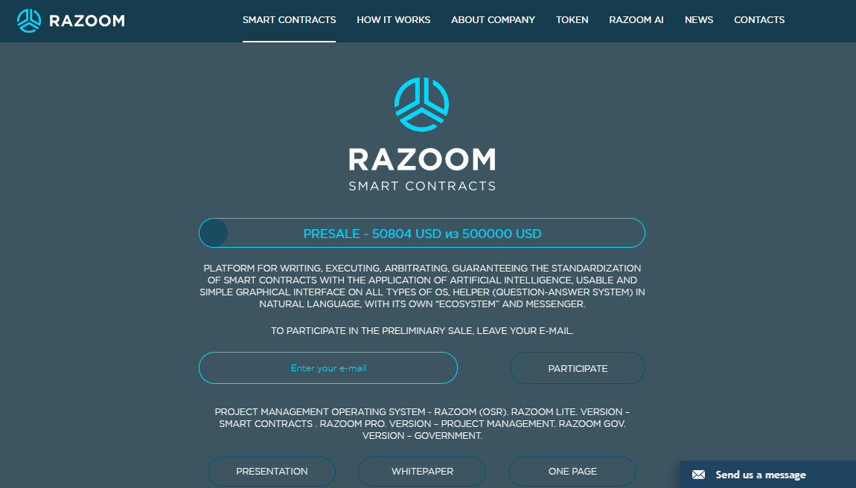
RAZOOM A unique system that combines artificial intelligence and blockchain technology. https://razoom.org/

Slide 17
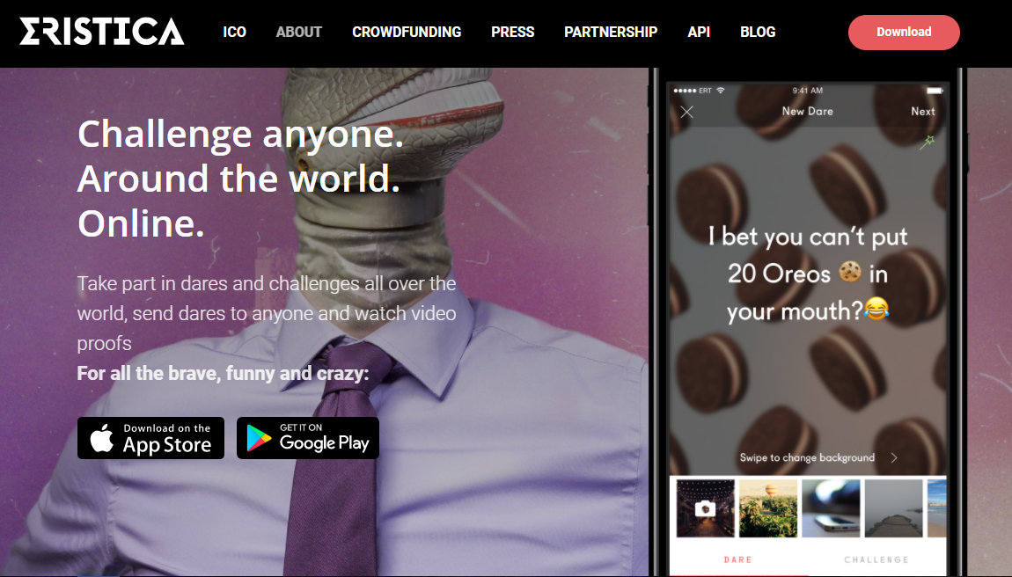

Slide 18
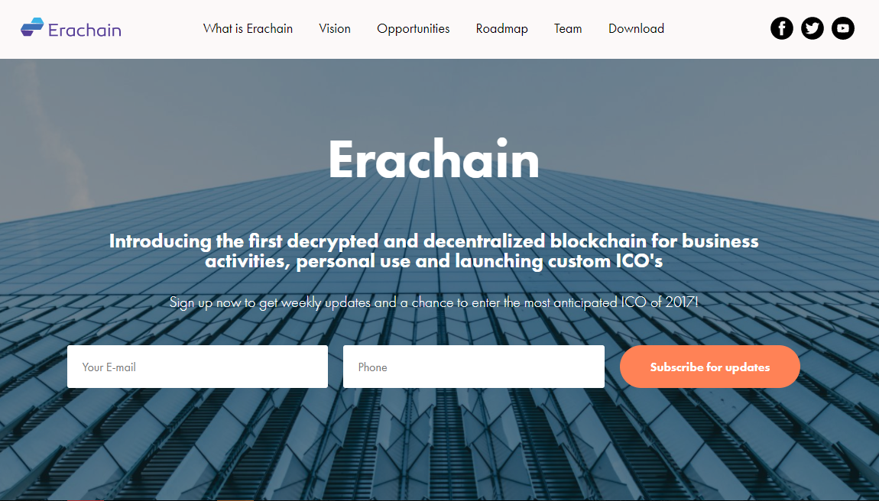

Slide 19
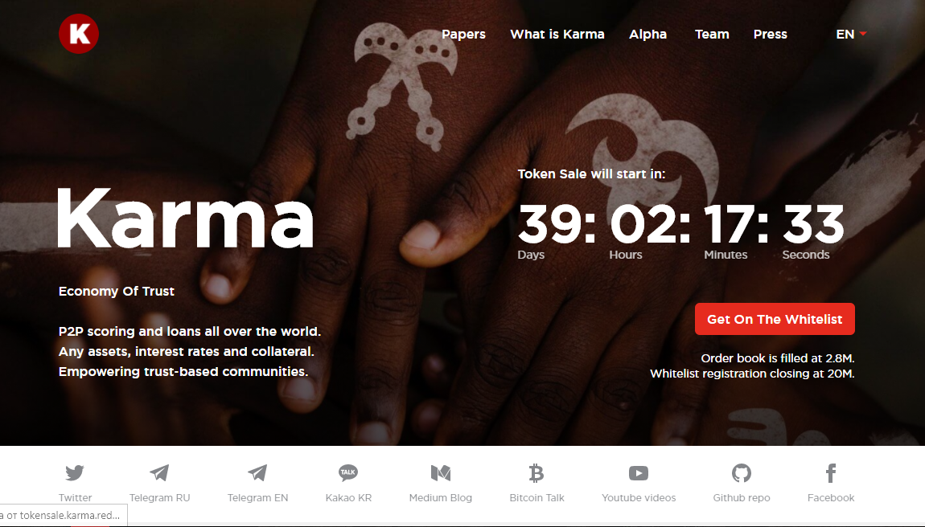

Slide 20
